Slide 1

Megaminx
MMR 2020 – Group 3

Slide 2
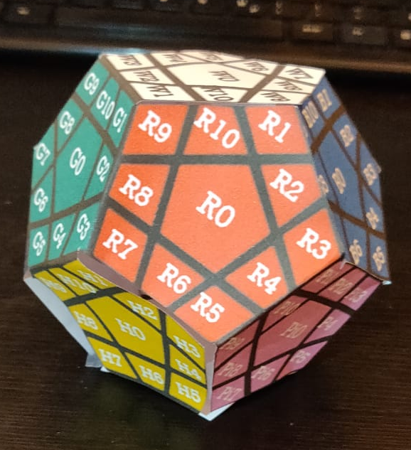
Beginning Position
u
Allowed Moves:
Up
Right
Front
Left
l
r
f
dl
dr

Slide 3
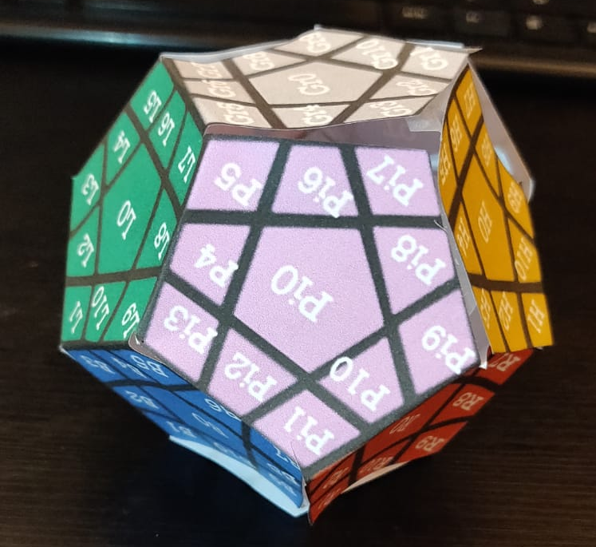
Axis Rotations
r_v
r_ud (upside down)

Slide 4
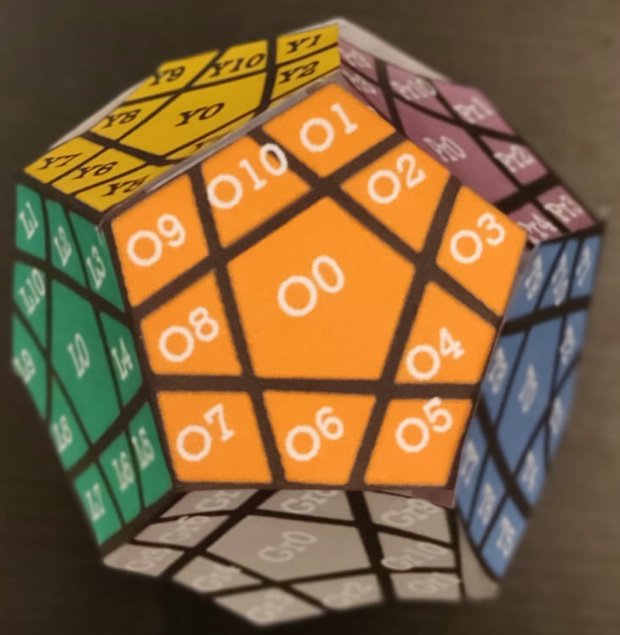
Numeration Method
u
br
bl
r
l
b
f
bdl
bdr
dl
dr
d

Slide 5
Numeration Method
u
br
bl
r
l
b
f
bdl
bdr
dl
dr
d

Slide 6
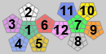
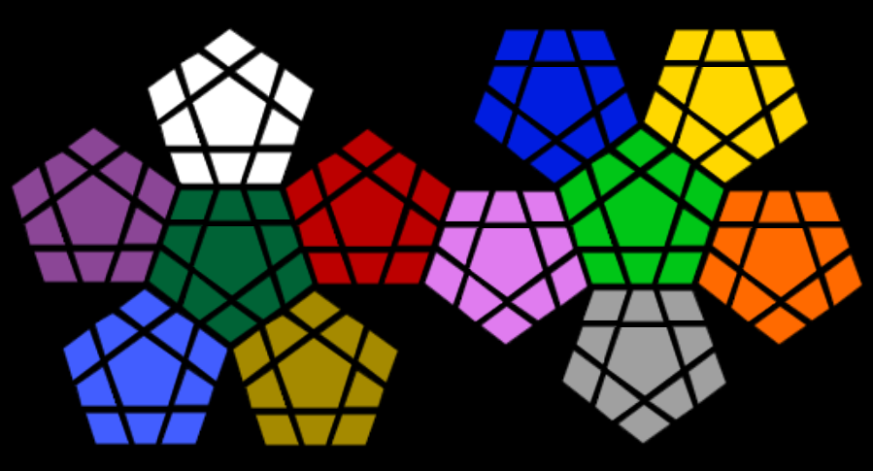
Numeration Method
G: Green
W: White
Pr: Purple
T: Turquoise
H: Honey
R: Red
L: Lime Green
Gr: Grey
O: Orange
Y: Yellow
B: Blue
Pi: Pink
W7
B9
B10
B1
Y9
Y10
Y1
W6
W8
B8
B2
Y8
Y2
W5
W0
W9
B0
Y0
W4
W10
B7
B3
Y7
Y3
Pr9
R1
B6
B4
L1
Y6
Y4
Pr8
Pr10
W3
W2
W1
R10
R2
B5
L10
L2
Y5
Pr7
Pr1
G9
G1
R9
R3
Pi1
L9
L3
O9
O10
O1
Pr0
G10
R0
Pi2
Pi3
L0
Pr6
Pr2
G8
G2
R8
R4
P10
P4
L8
L4
O8
O2
Pr5
Pr4
Pr3
G0
R7
R6
R5
Pi0
L7
L6
L5
O0
G7
G3
Pi9
P5
O7
O3
T1
G6
G4
H1
Pi8
Pi6
Gr5
Gr6
Gr7
O6
O4
T10
T2
G5
H10
Pi7
O5
T9
H9
H2
Gr4
Gr0
Gr8
T0
T3
H3
T8
H0
Gr3
Gr9
T4
H8
H4
Gr2
Gr10
T7
T6
T5
H7
H6
H5
Gr1

Slide 7
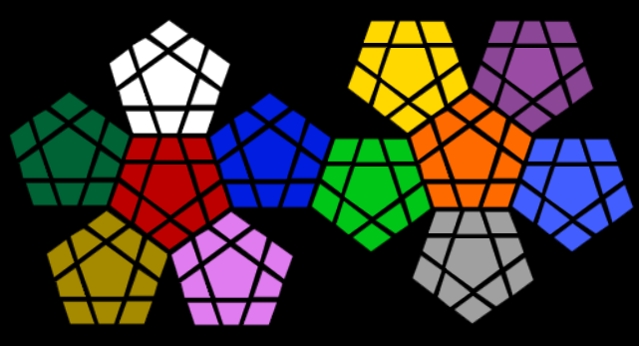
Numeration Method
G: Green
W: White
Pr: Purple
T: Turquoise
H: Honey
R: Red
L: Lime Green
Gr: Grey
O: Orange
Y: Yellow
B: Blue
Pi: Pink
W5
W4
W6
W3
W7
W0
W2
W8
W1
W10
W9
Gr7
Gr8
Gr9
Gr6
Gr0
Gr10
Gr5
Gr1
Gr4
Gr2
Gr3

Slide 8
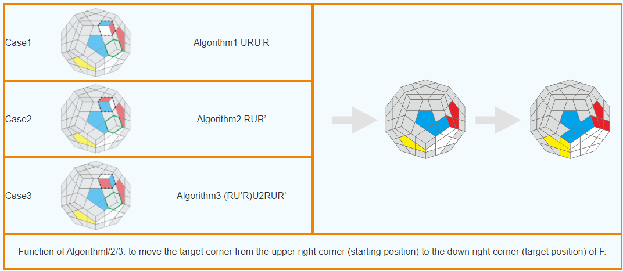
ALGORITHMS
SP1
l dl l‘

Slide 9
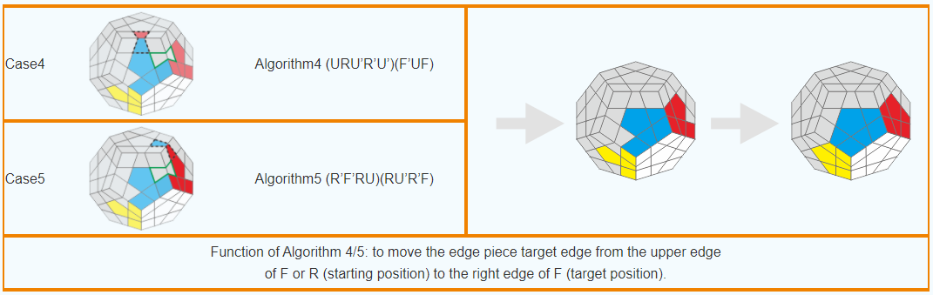
ALGORITHMS
SP2
(dl l dl‘ l‘ dl‘) (f‘ dl f)

Slide 10
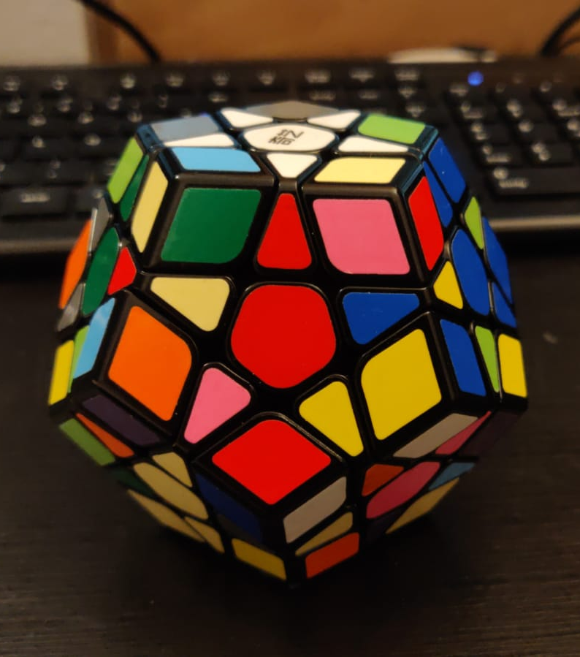
Goals
Goal 1
Moves: all basic moves

Slide 11
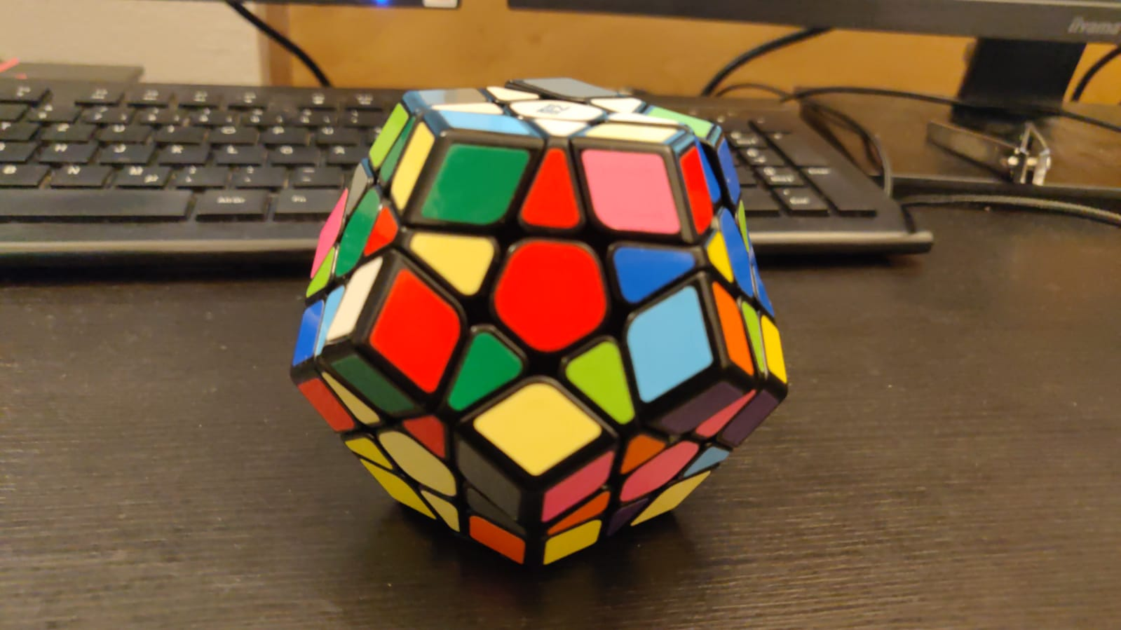
Goals
Goal 2
Moves: all basic moves

Slide 12
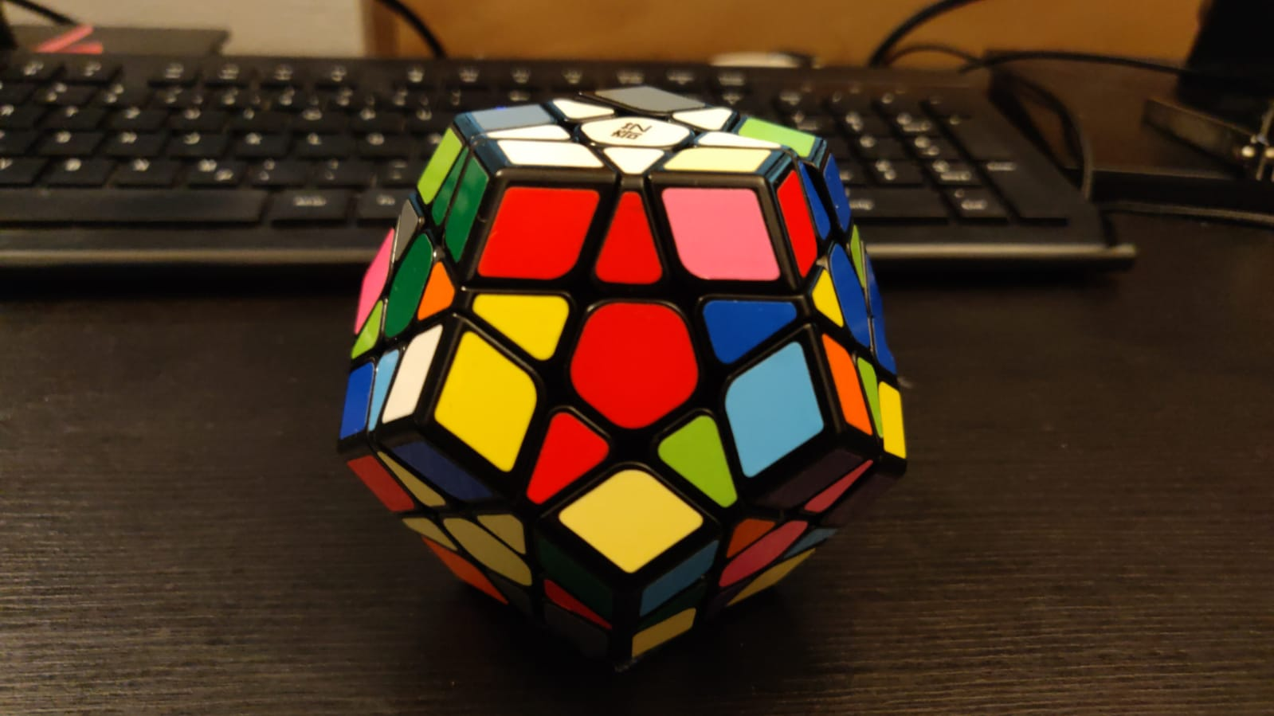
Goals
Goal 3
Moves: Sp1

Slide 13
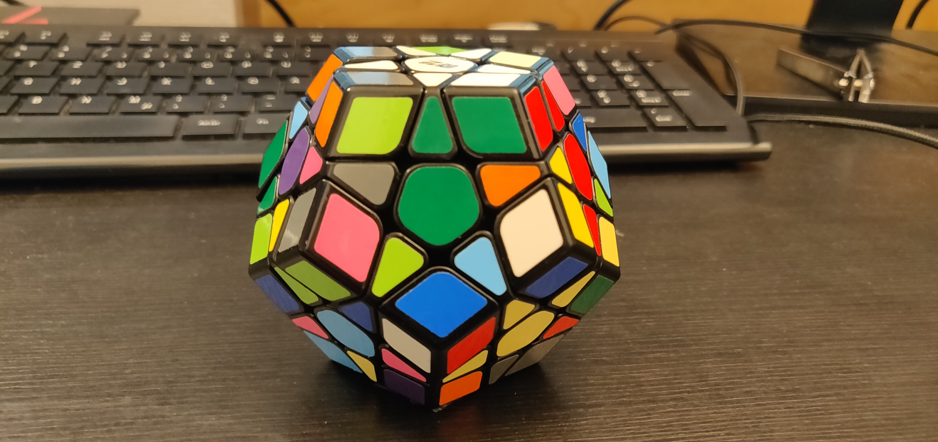
Goals
Goal 4
Moves: -r_v

Slide 14
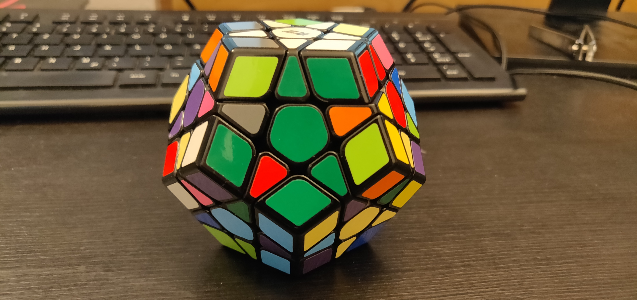
Goals
Goal 5
Moves: all basic moves

Slide 15
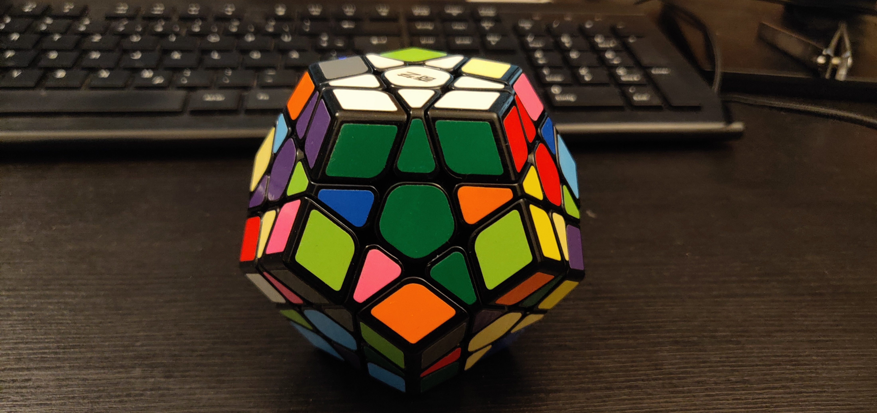
Goals
Goal 6
Moves: Sp1

Slide 16
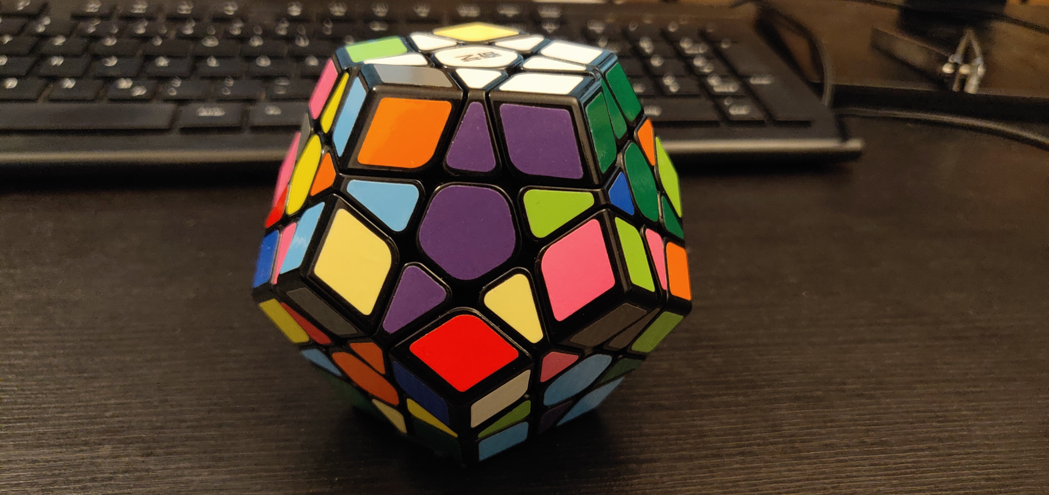
Goals
Goal 7
Moves: -r_v

Slide 17
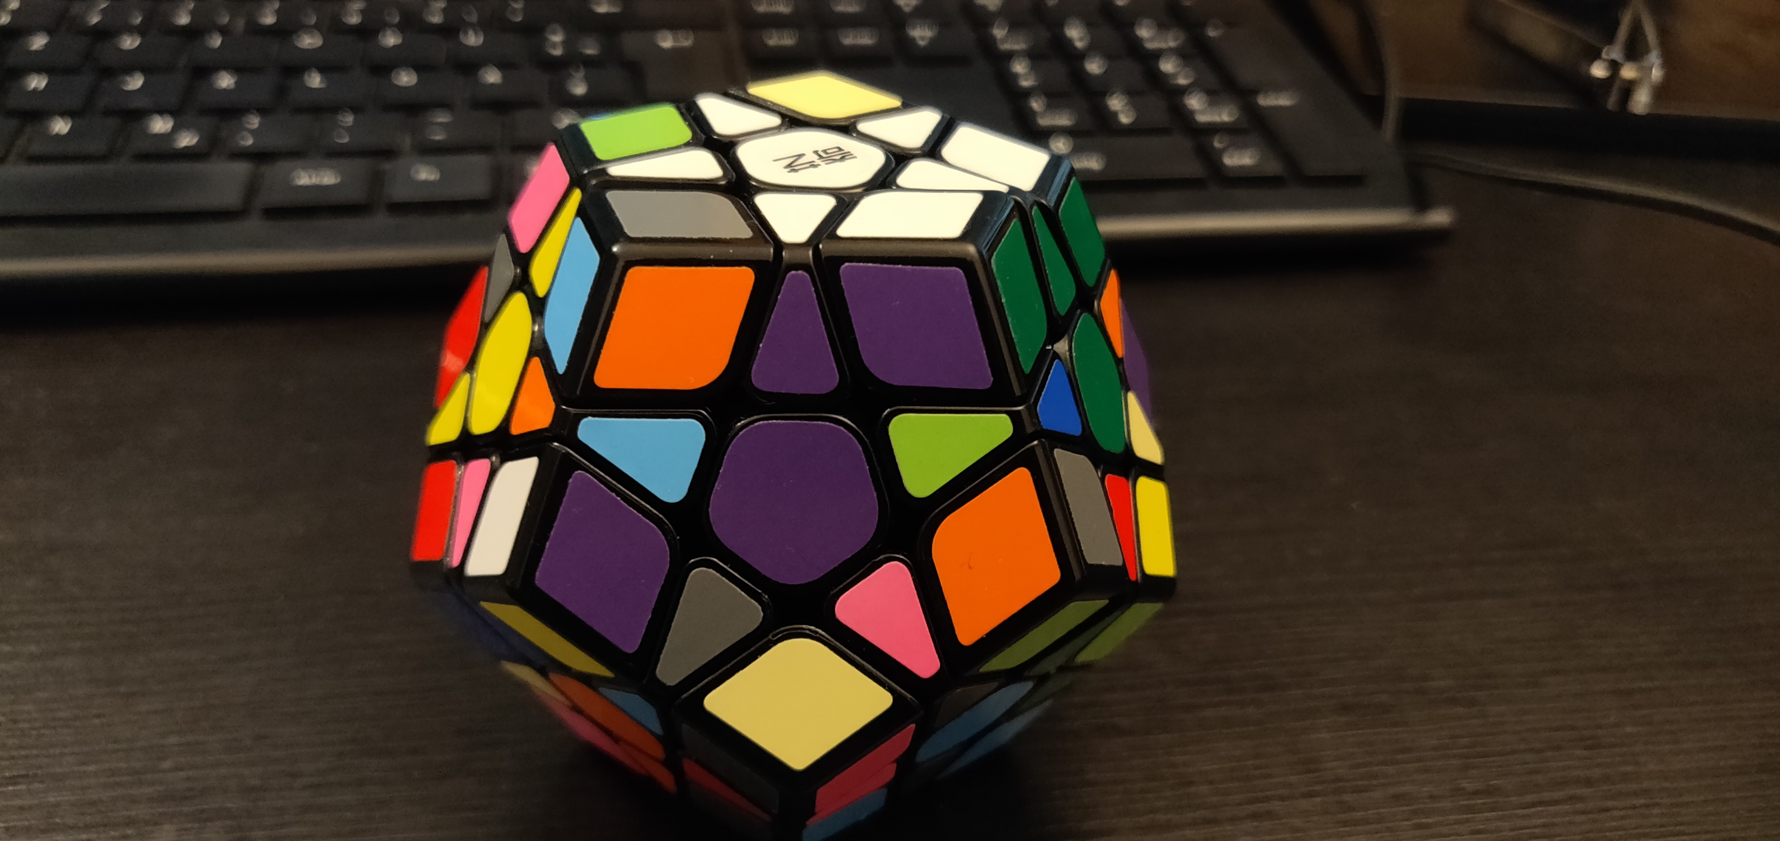
Goals
Goal 8
Moves: all basic moves

Slide 18
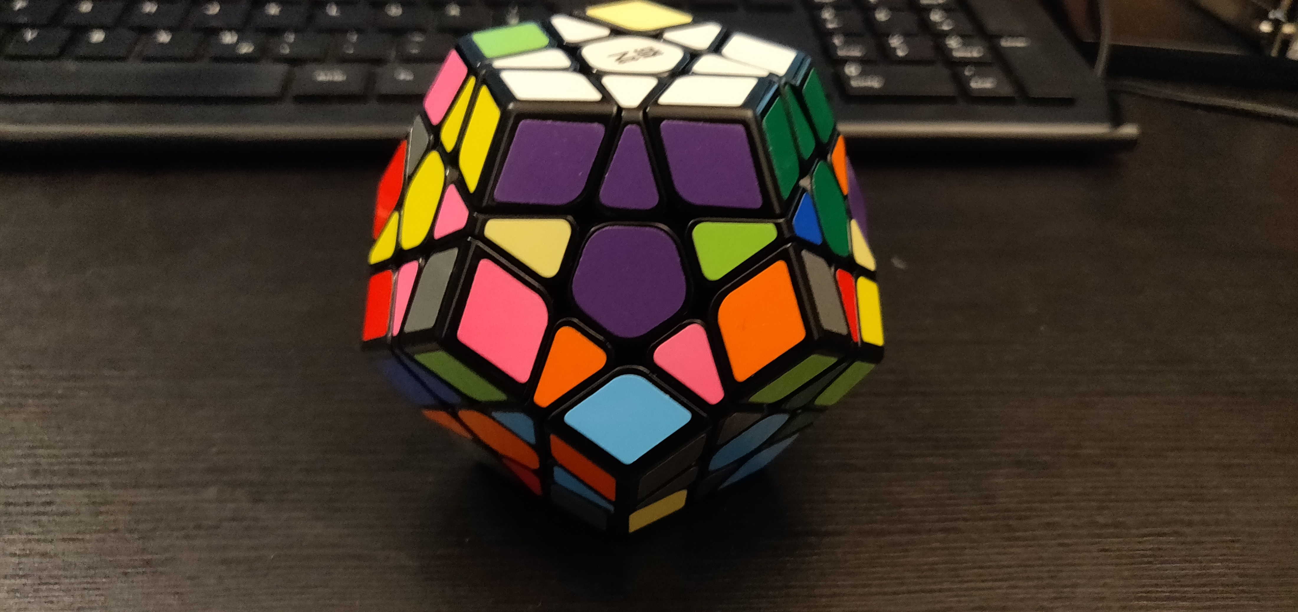
Goals
Goal 9
Moves: Sp1

Slide 19
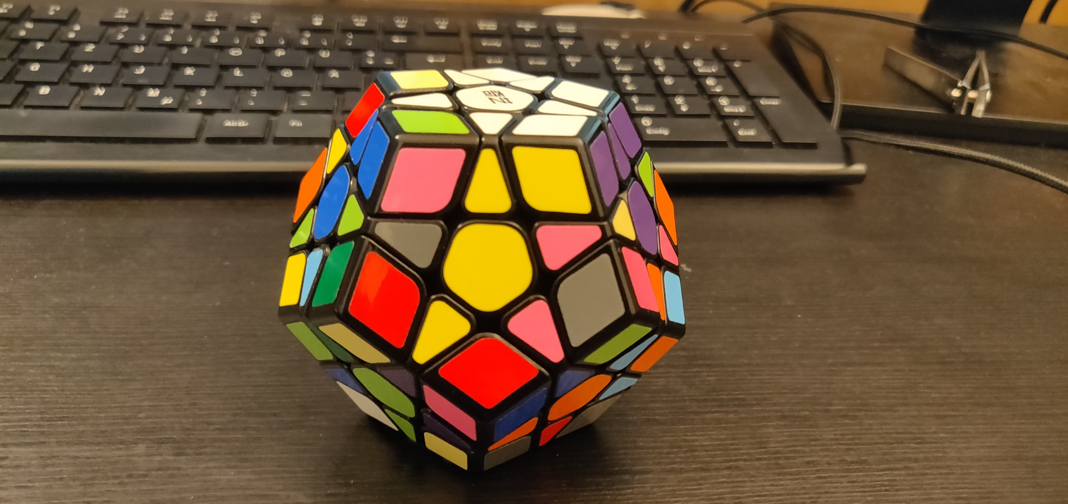
Goals
Goal 10
Moves: -r_v

Slide 20
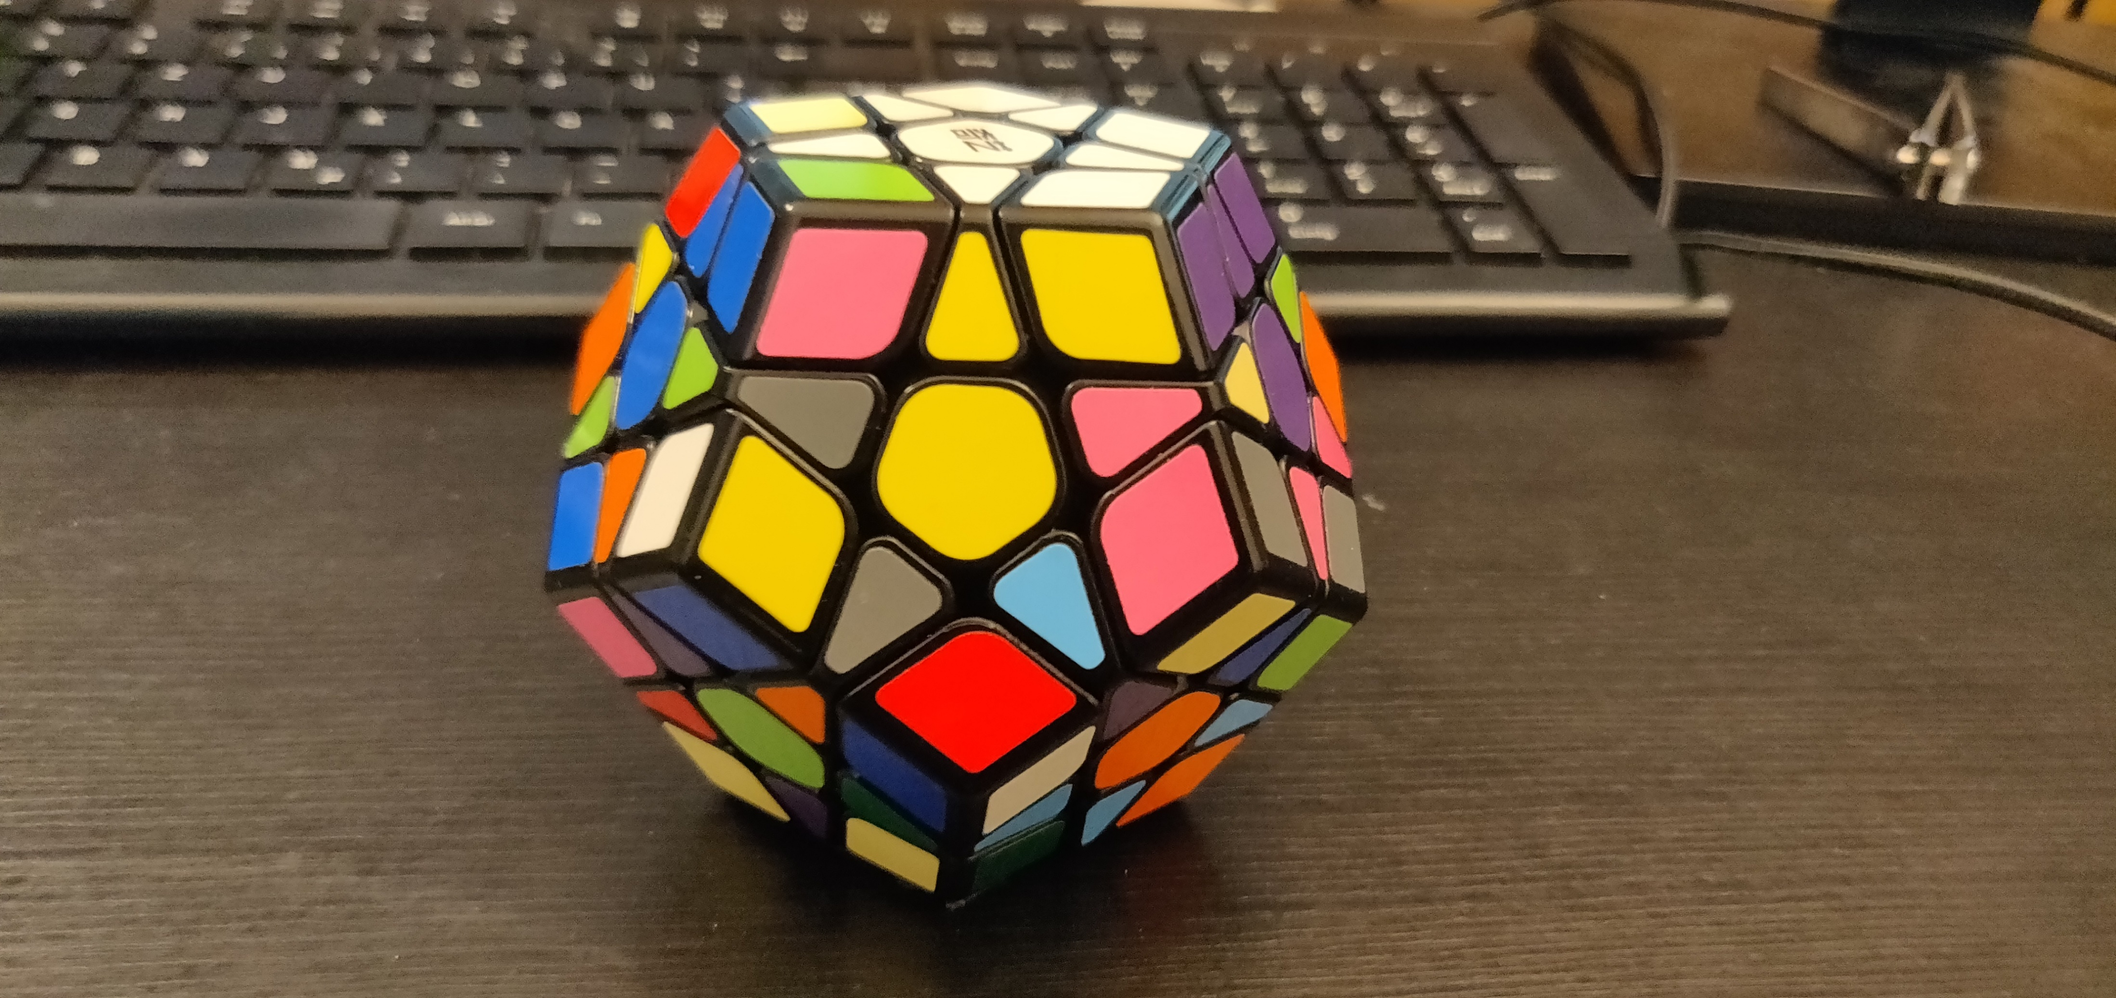
Goals
Goal 11
Moves: all basic moves

Slide 21
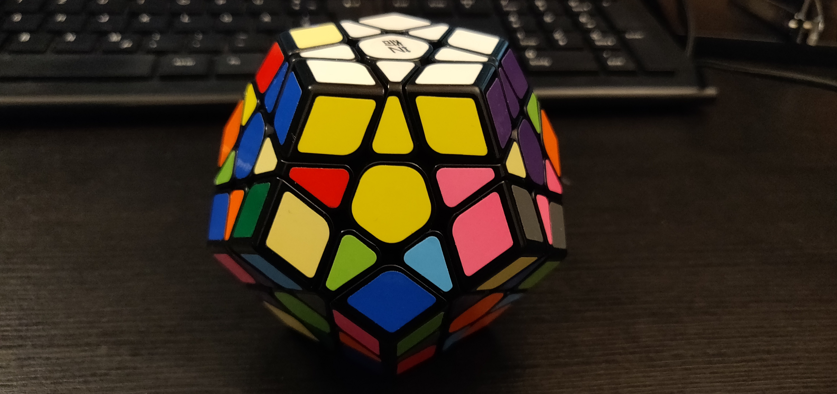
Goals
Goal 12
Moves: Sp1

Slide 22
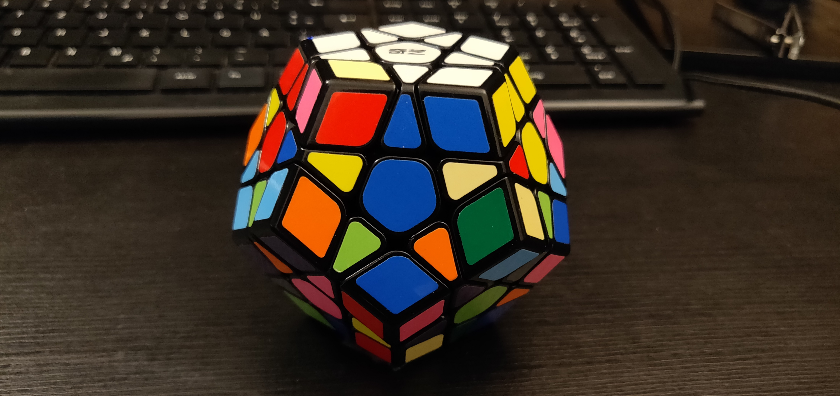
Goals
Goal 13
Moves: -r_v

Slide 23
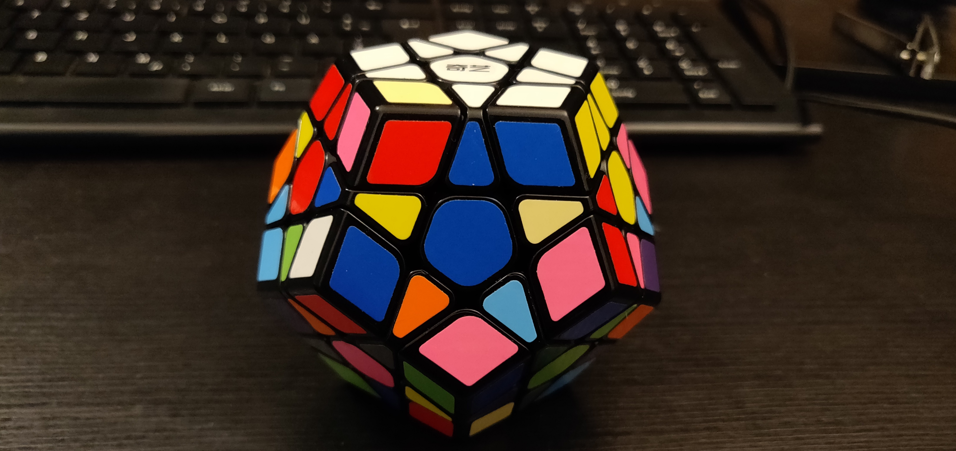
Goals
Goal 14
Moves: all basic moves

Slide 24
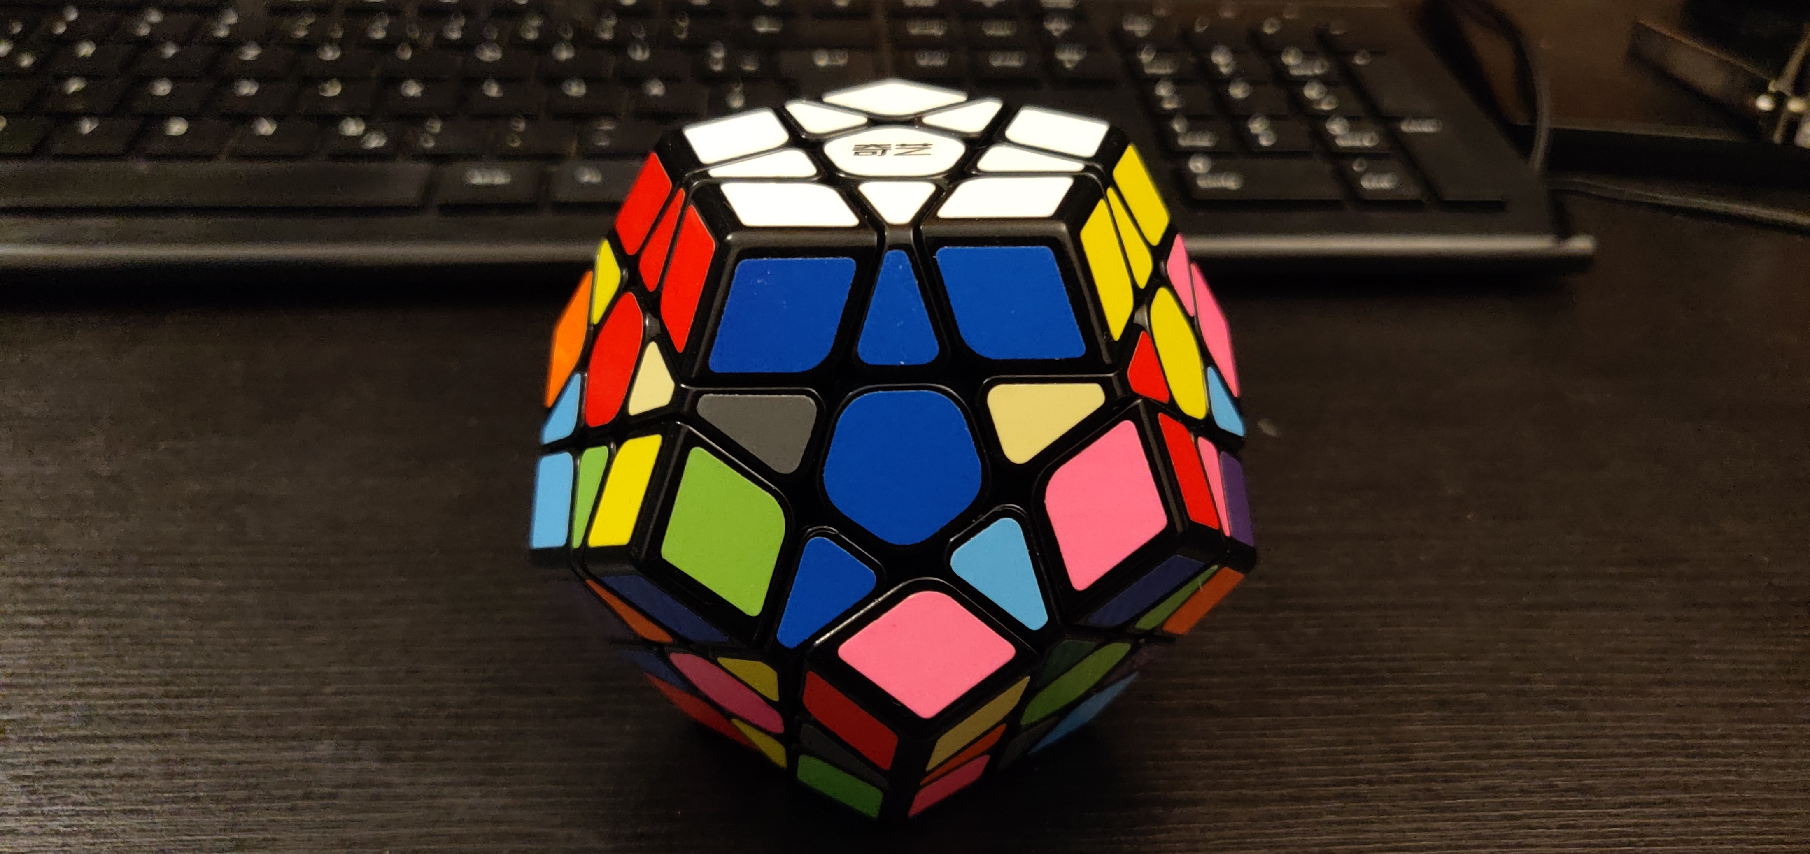
Goals
Goal 15
Moves: Sp1

Slide 25
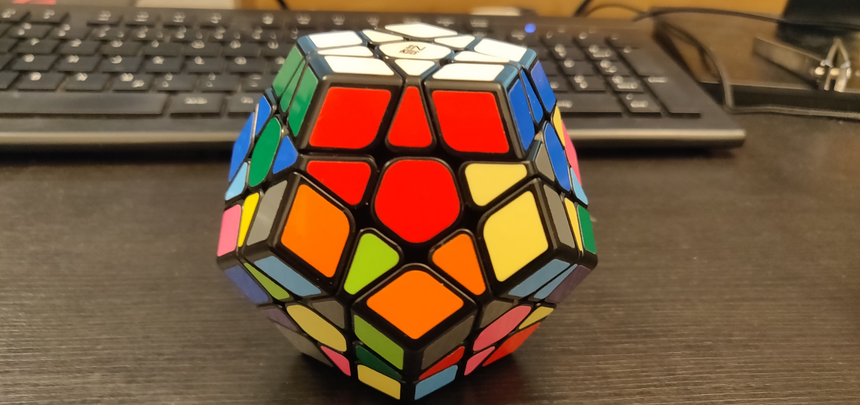
Goals
Goal 16
Moves: -r_v

Slide 26
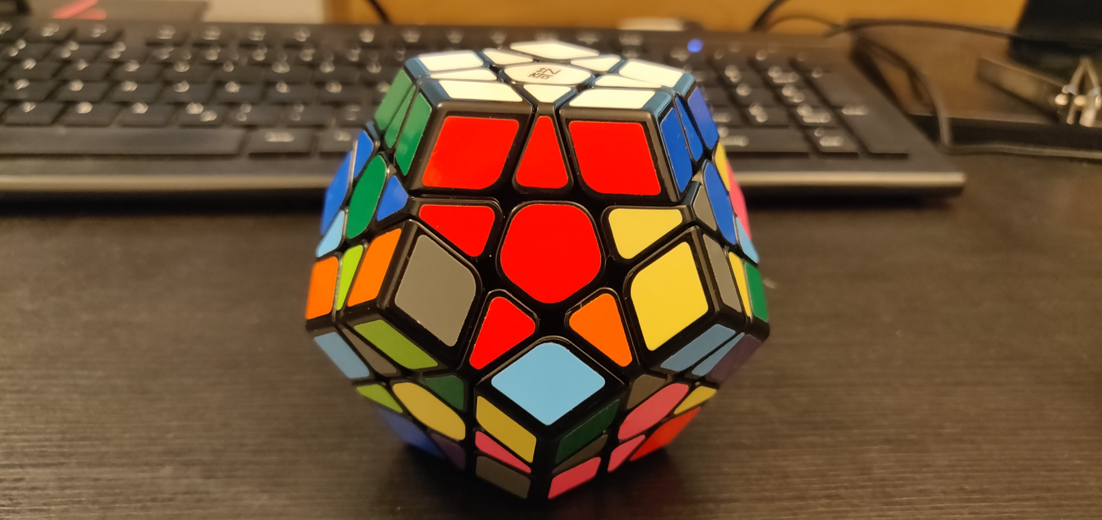
Goals
Goal 17

Slide 27
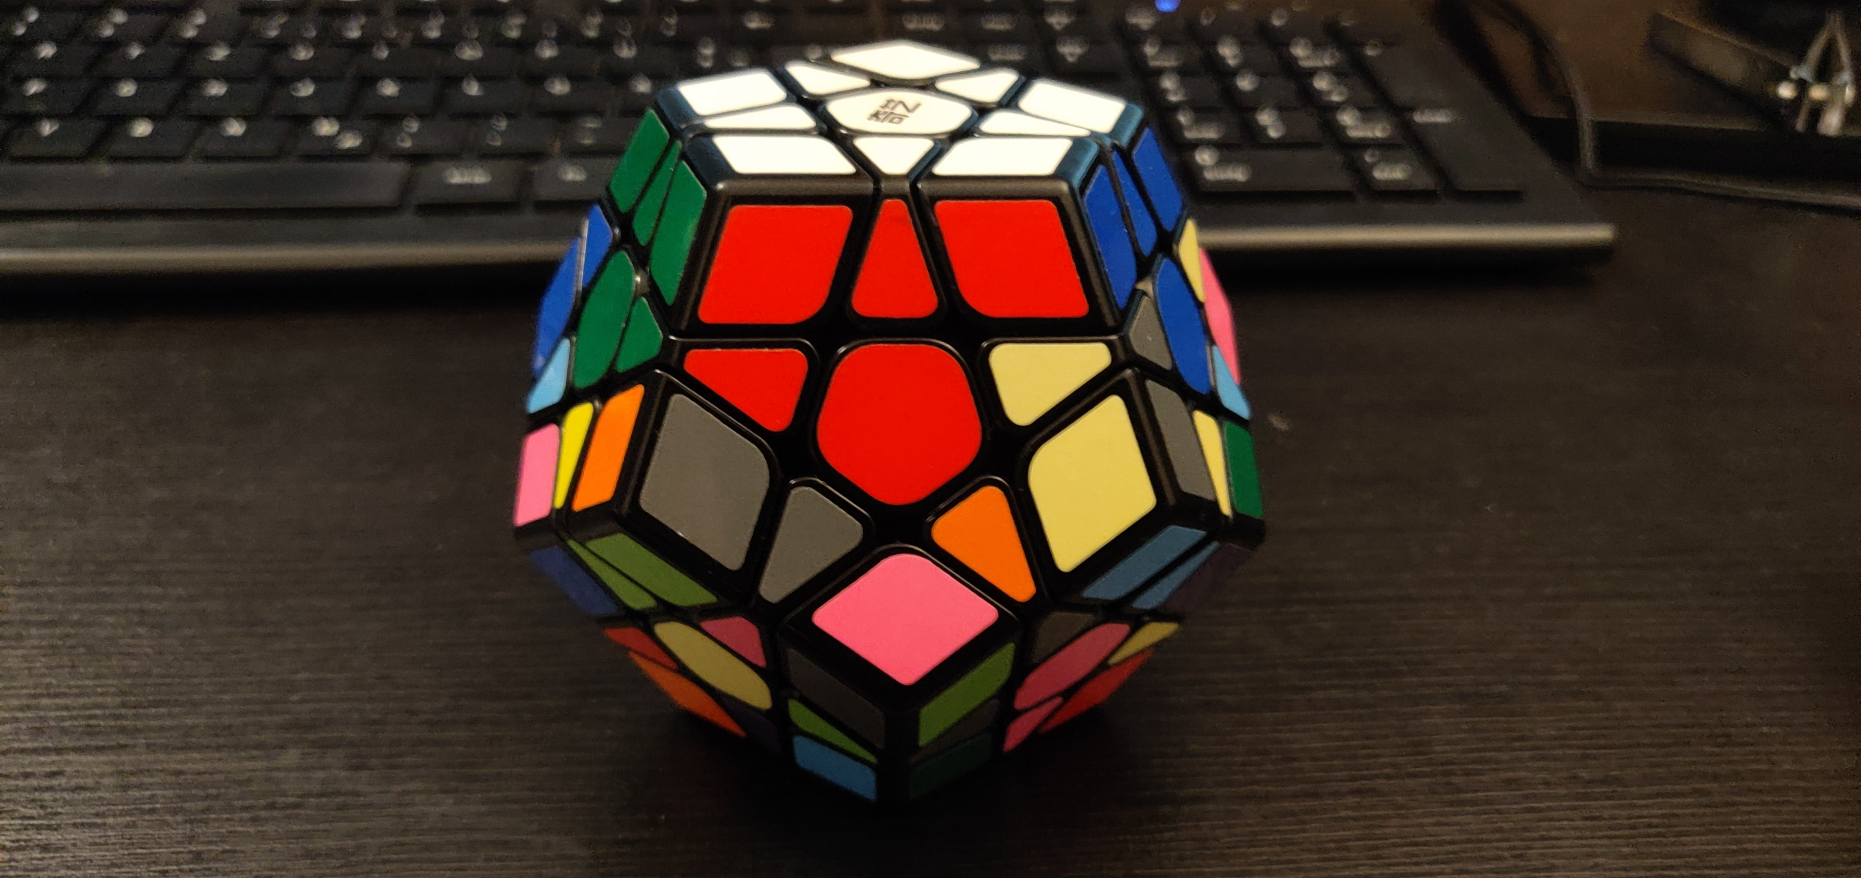
Goals
Goal 18

Slide 28
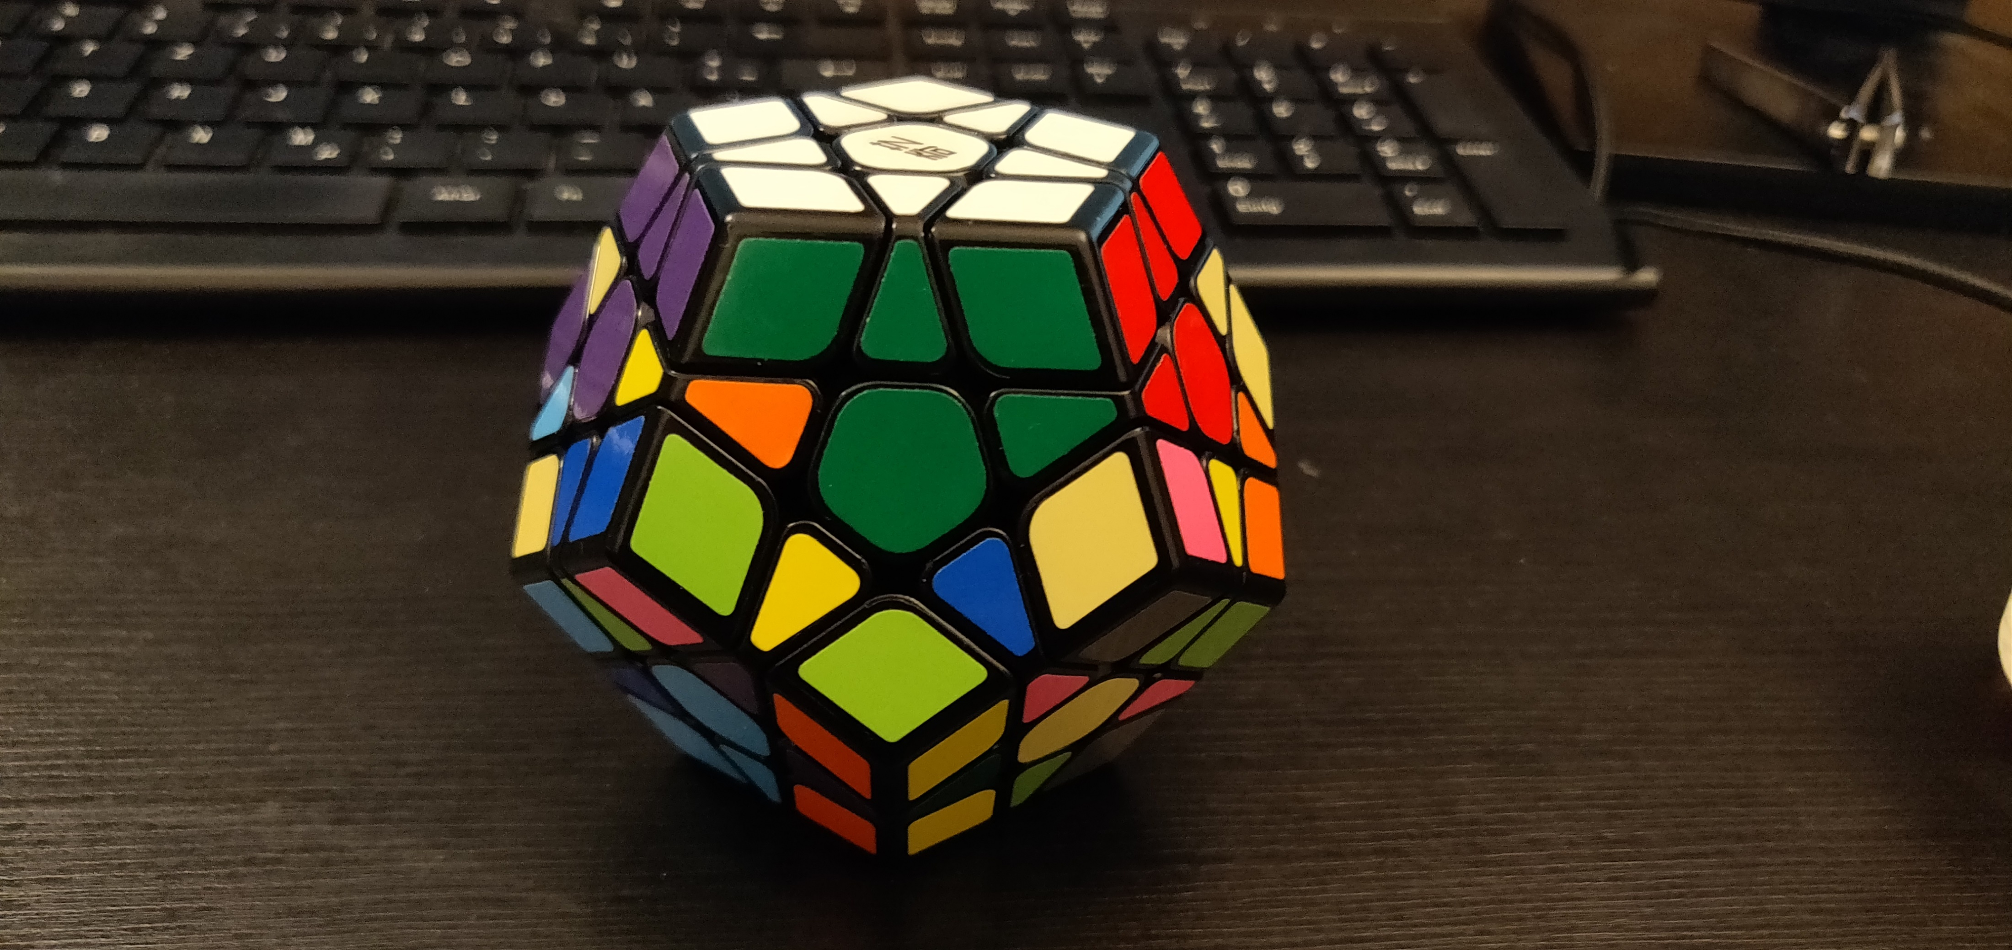
Goals
Goal 19

Slide 29
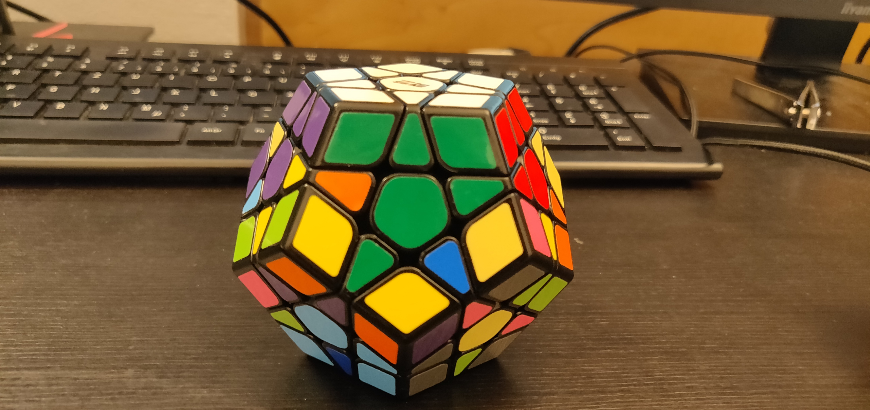
Goals
Goal 20

Slide 30
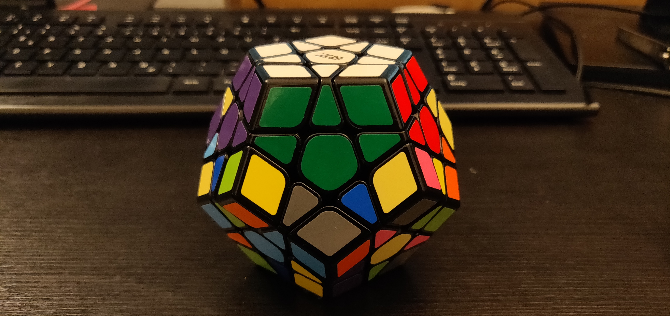
Goals
Goal 21

Slide 31
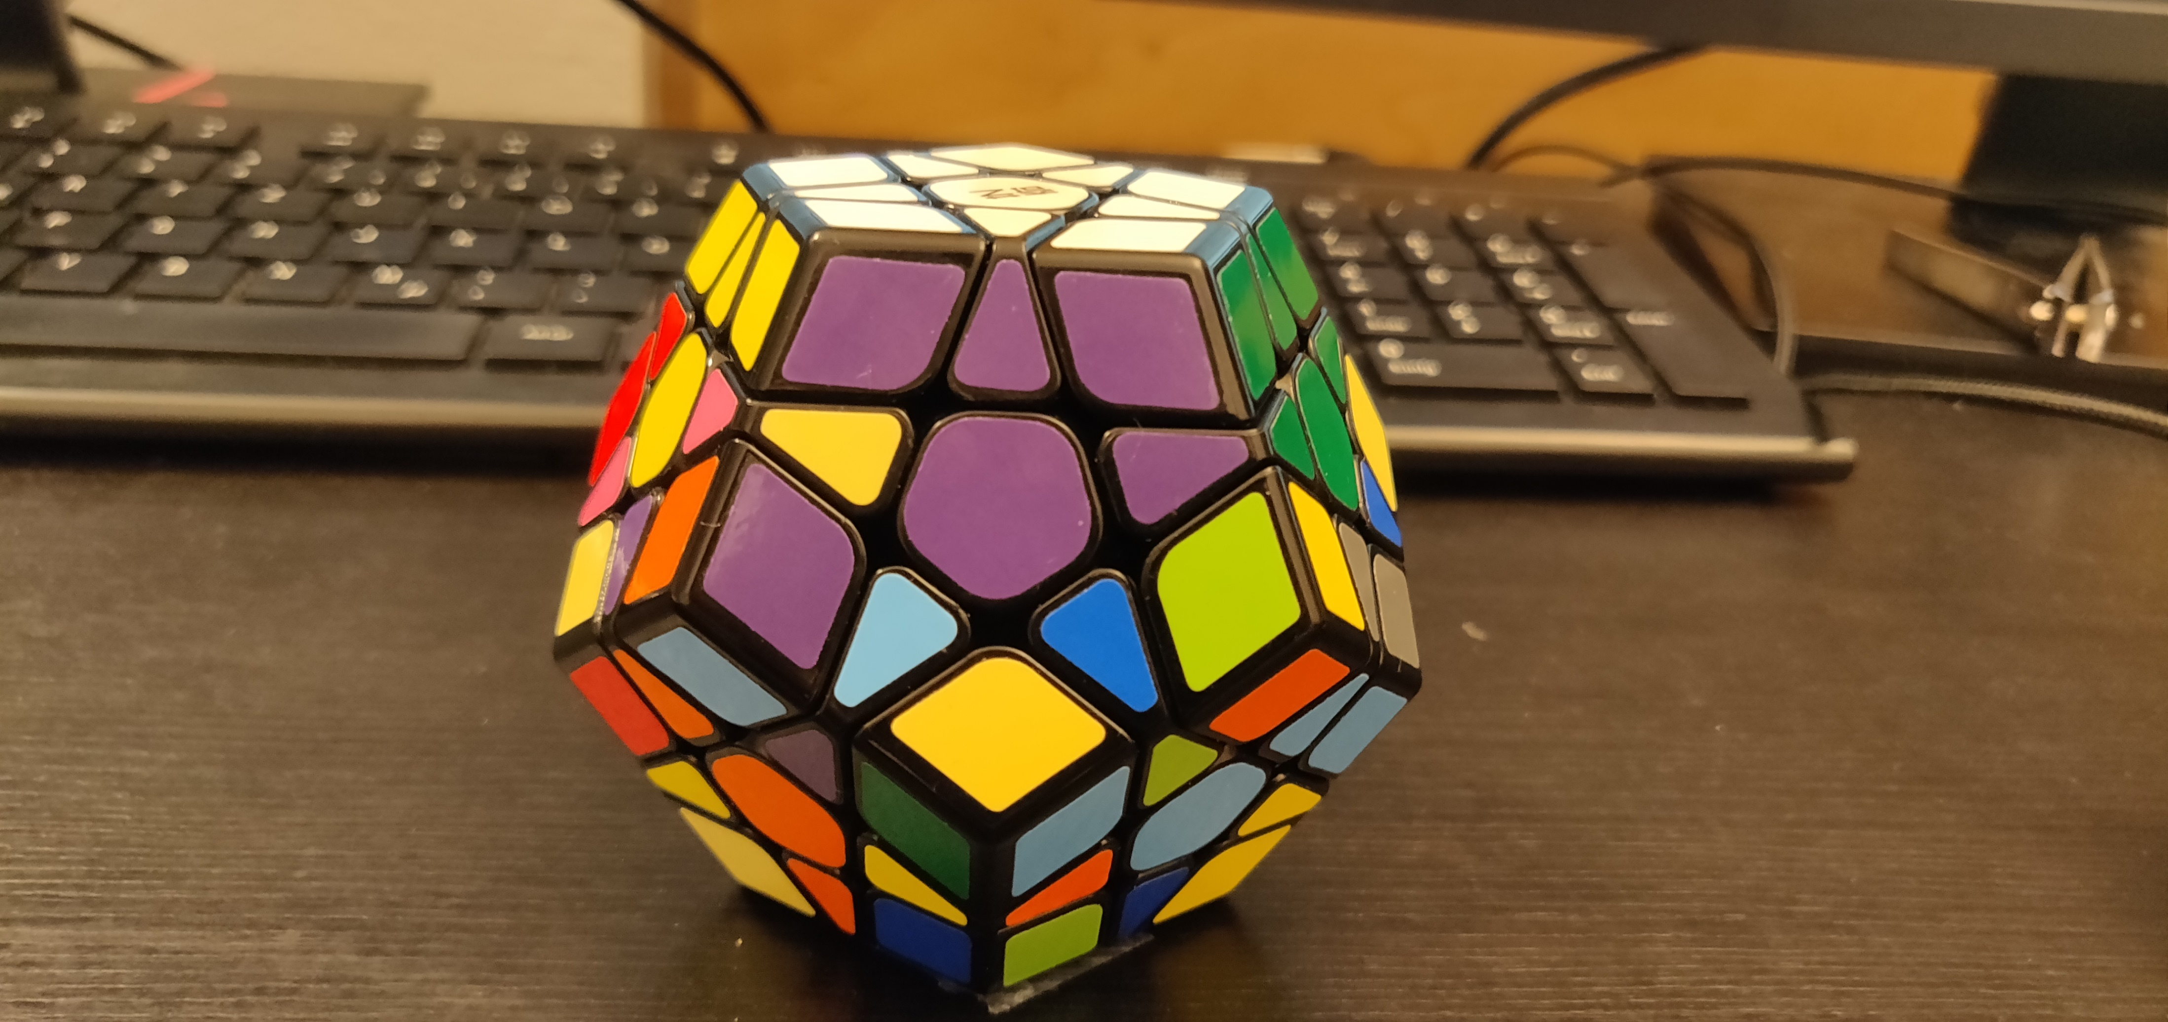
Goals
Goal 22

Slide 32
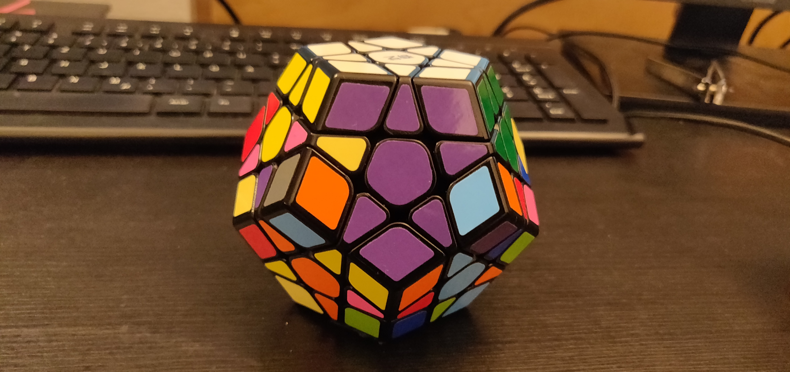
Goals
Goal 23

Slide 33
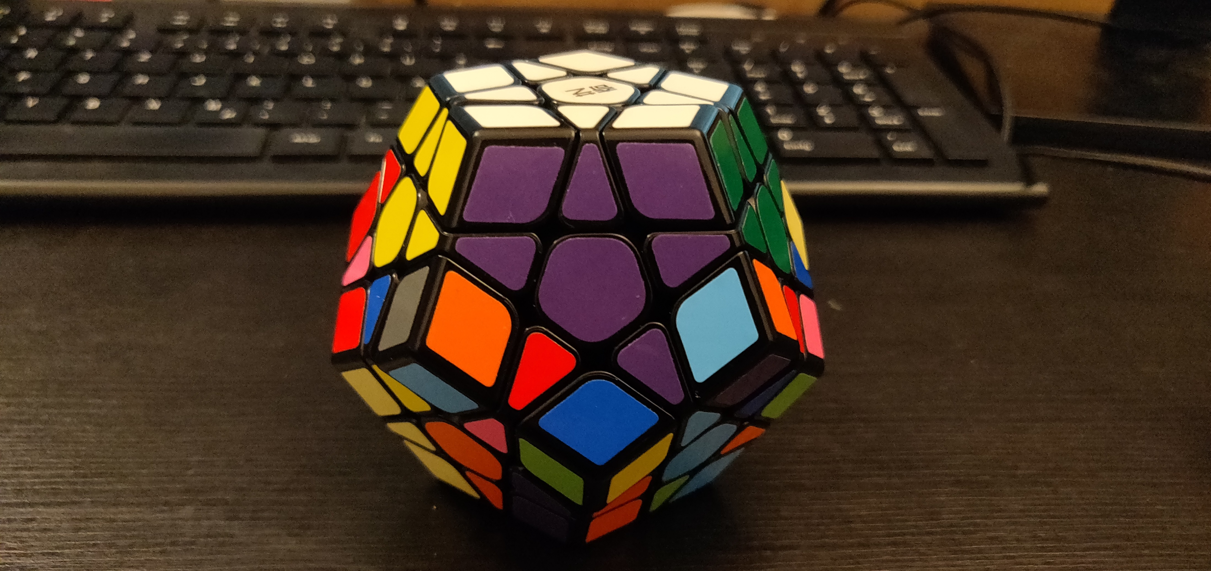
Goals
Goal 24

Slide 34
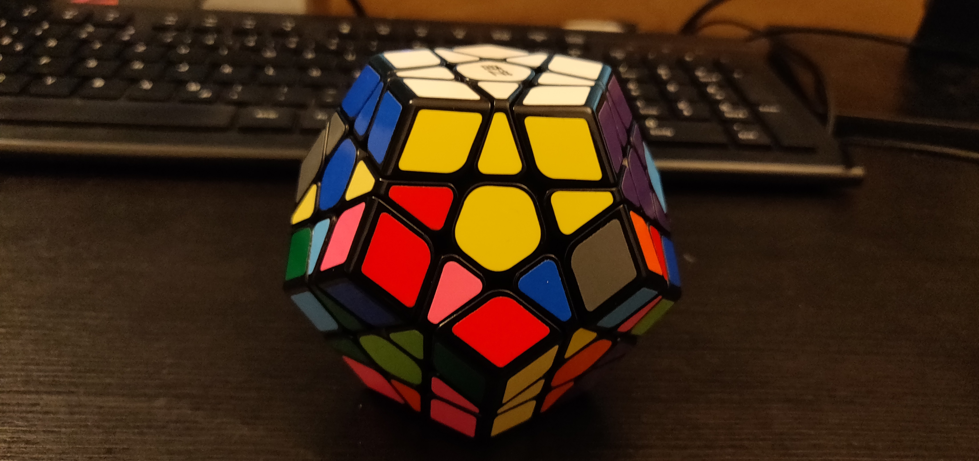
Goals
Goal 25

Slide 35
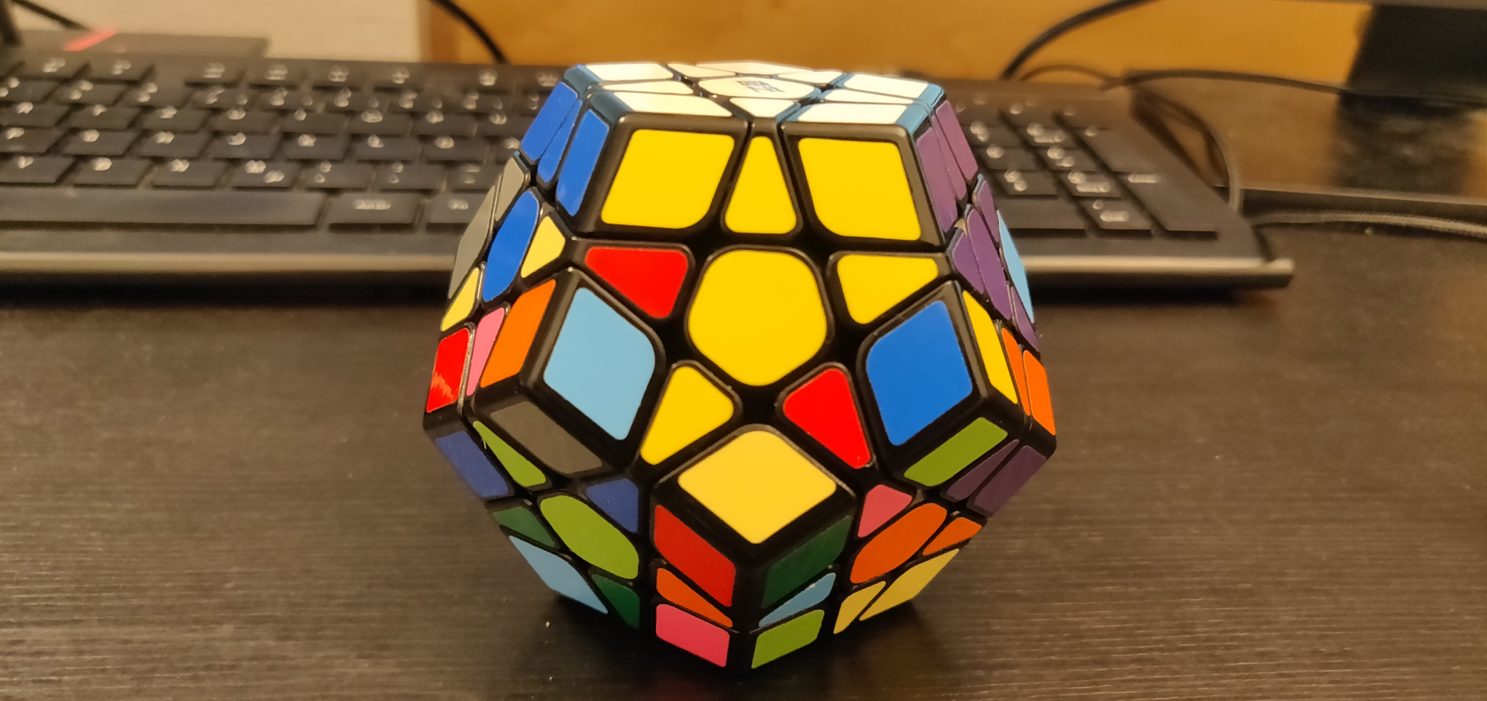
Goals
Goal 26

Slide 36
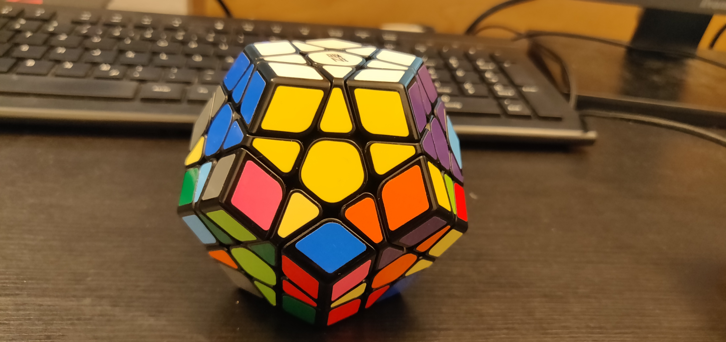
Goals
Goal 27

Slide 37
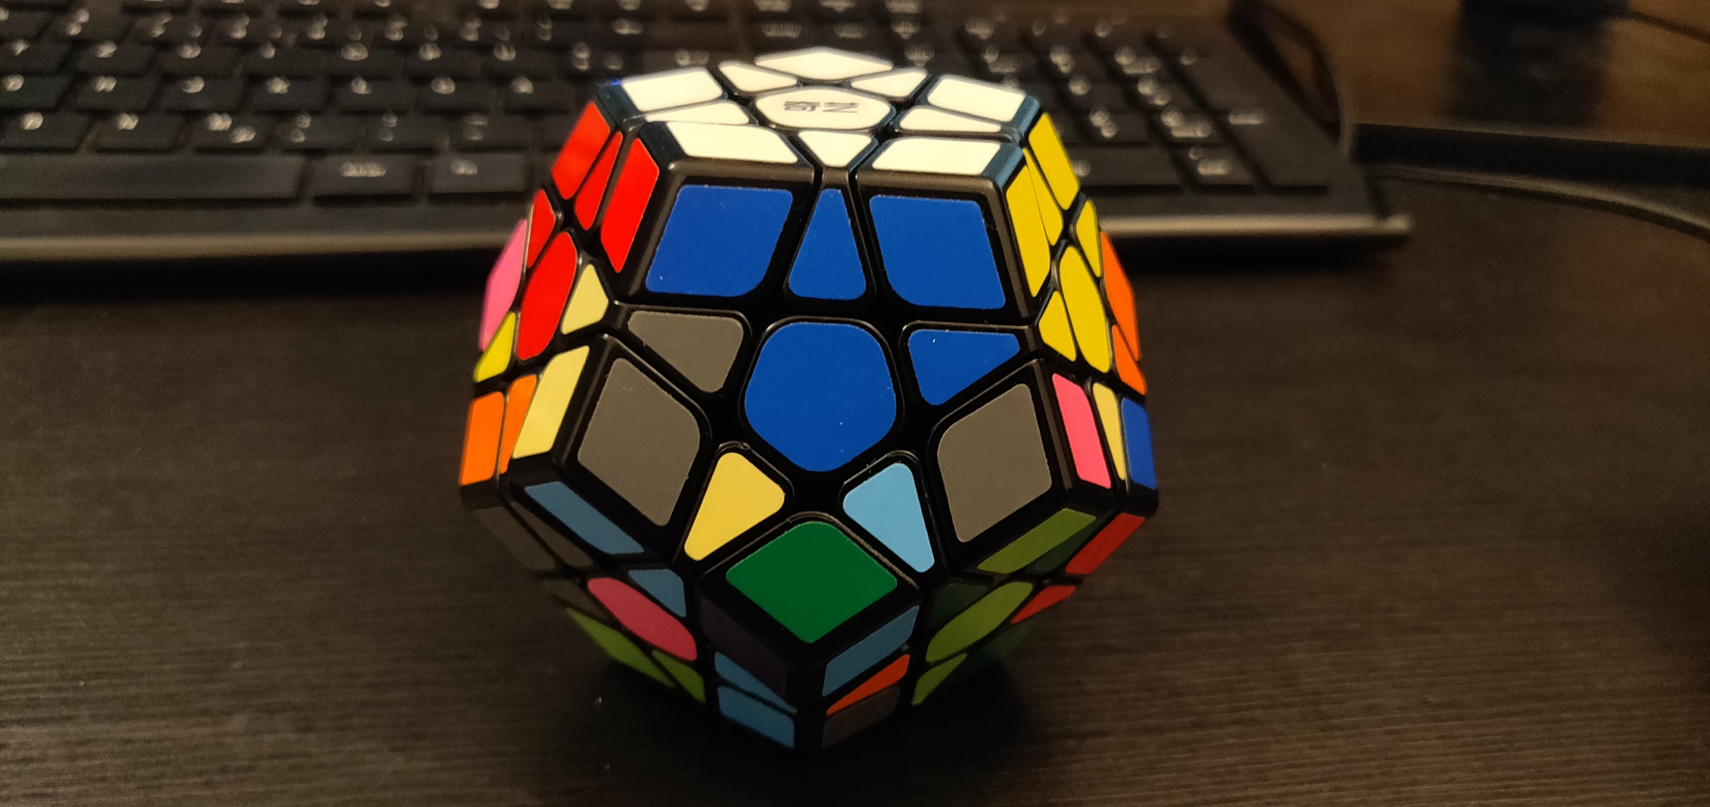
Goals
Goal 28

Slide 38
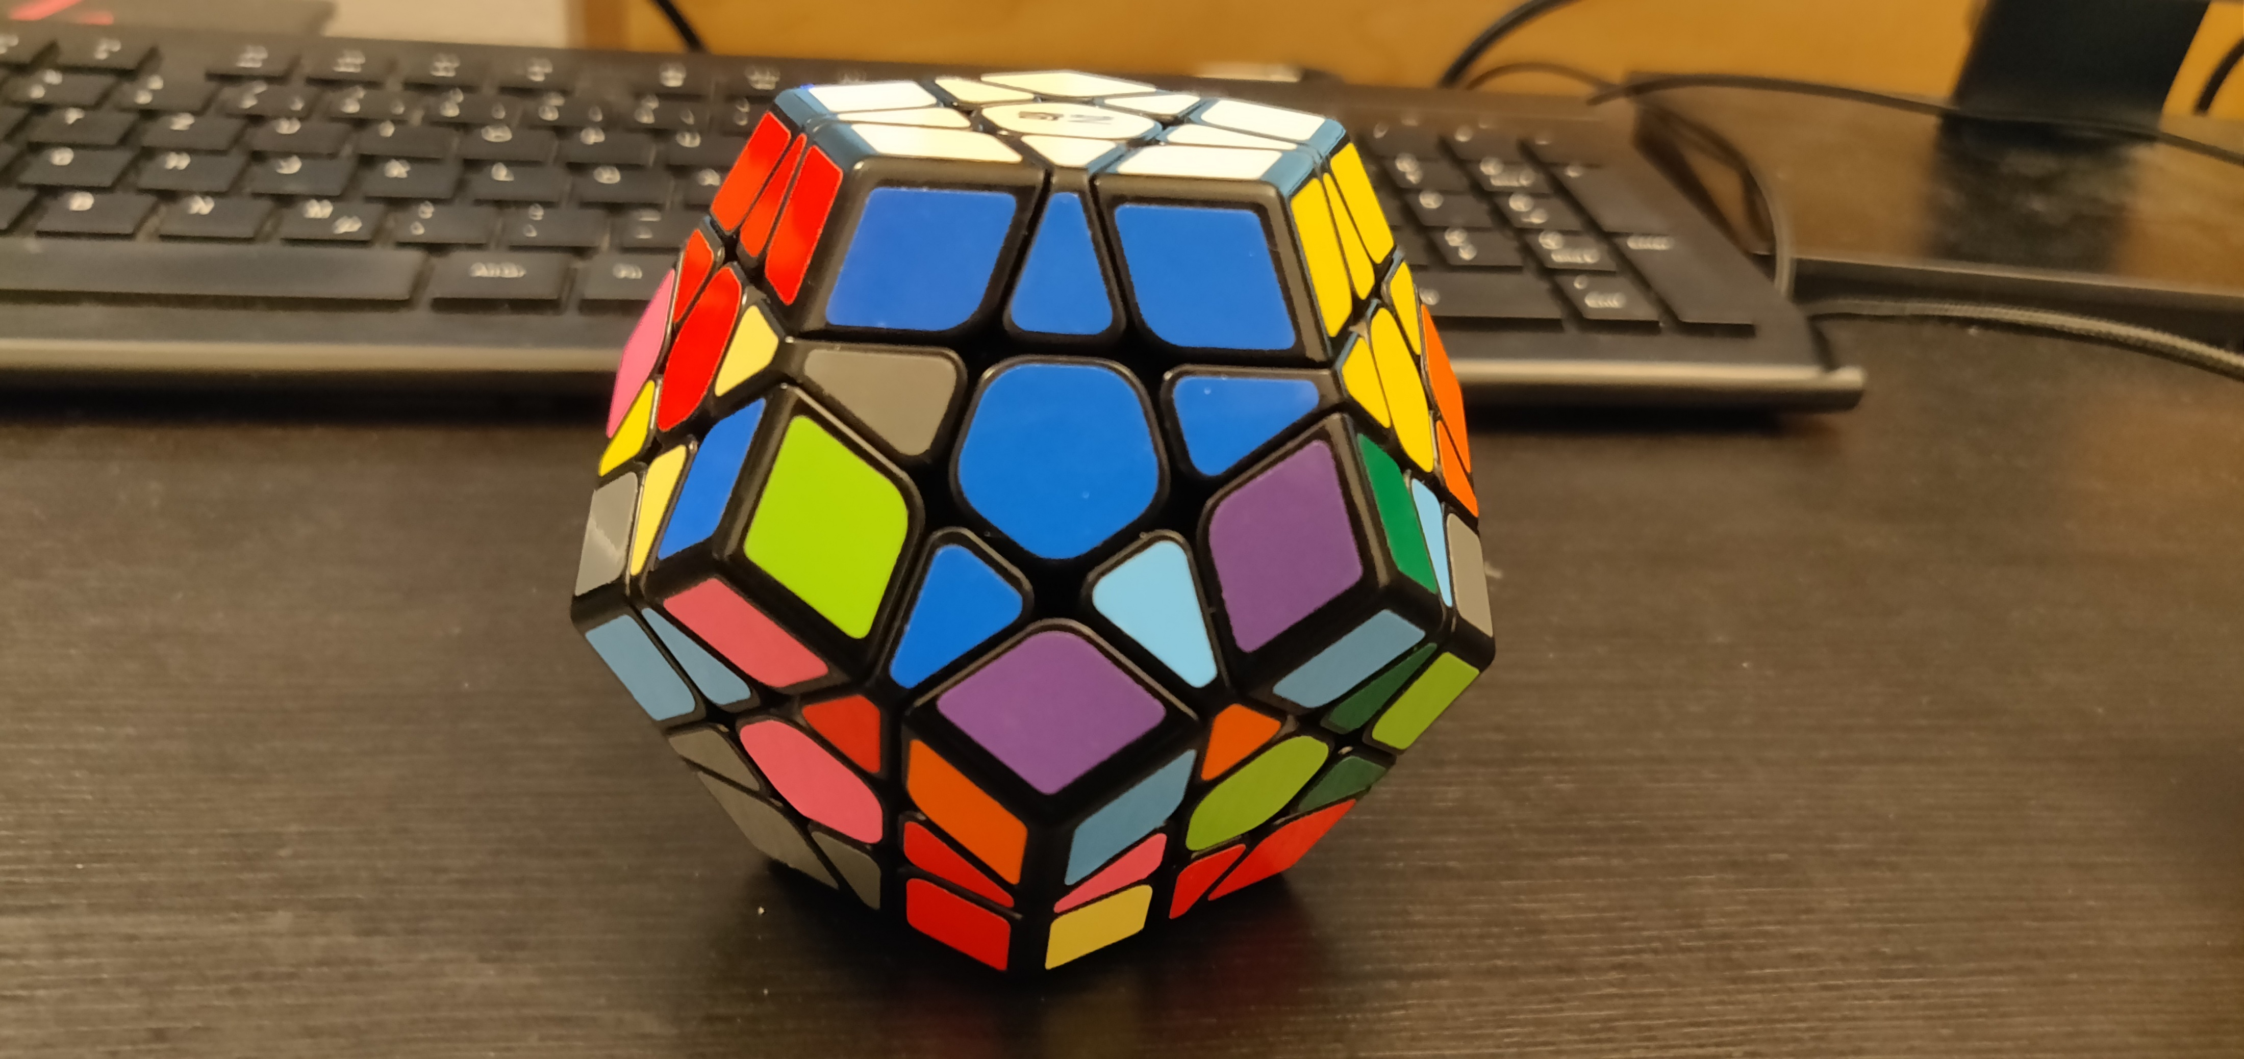
Goals
Goal 29

Slide 39
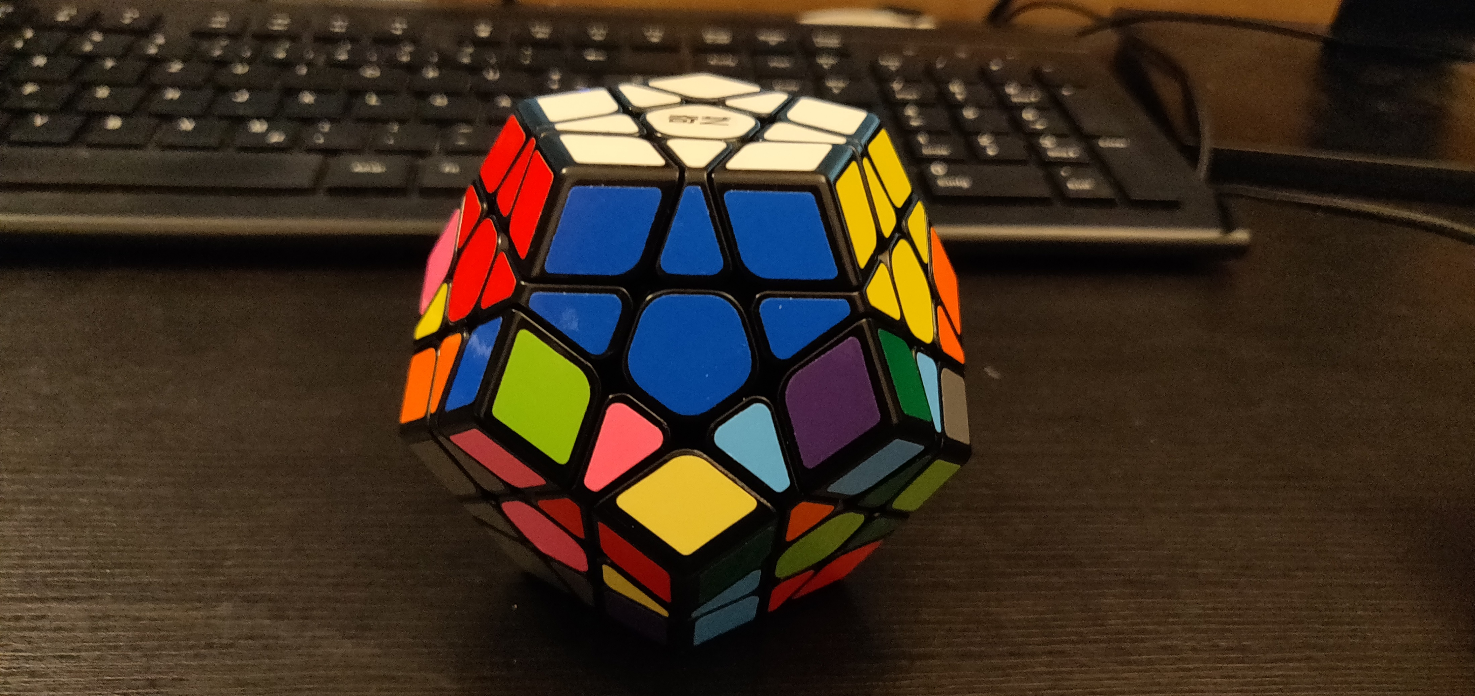
Goals
Goal 30

Slide 40
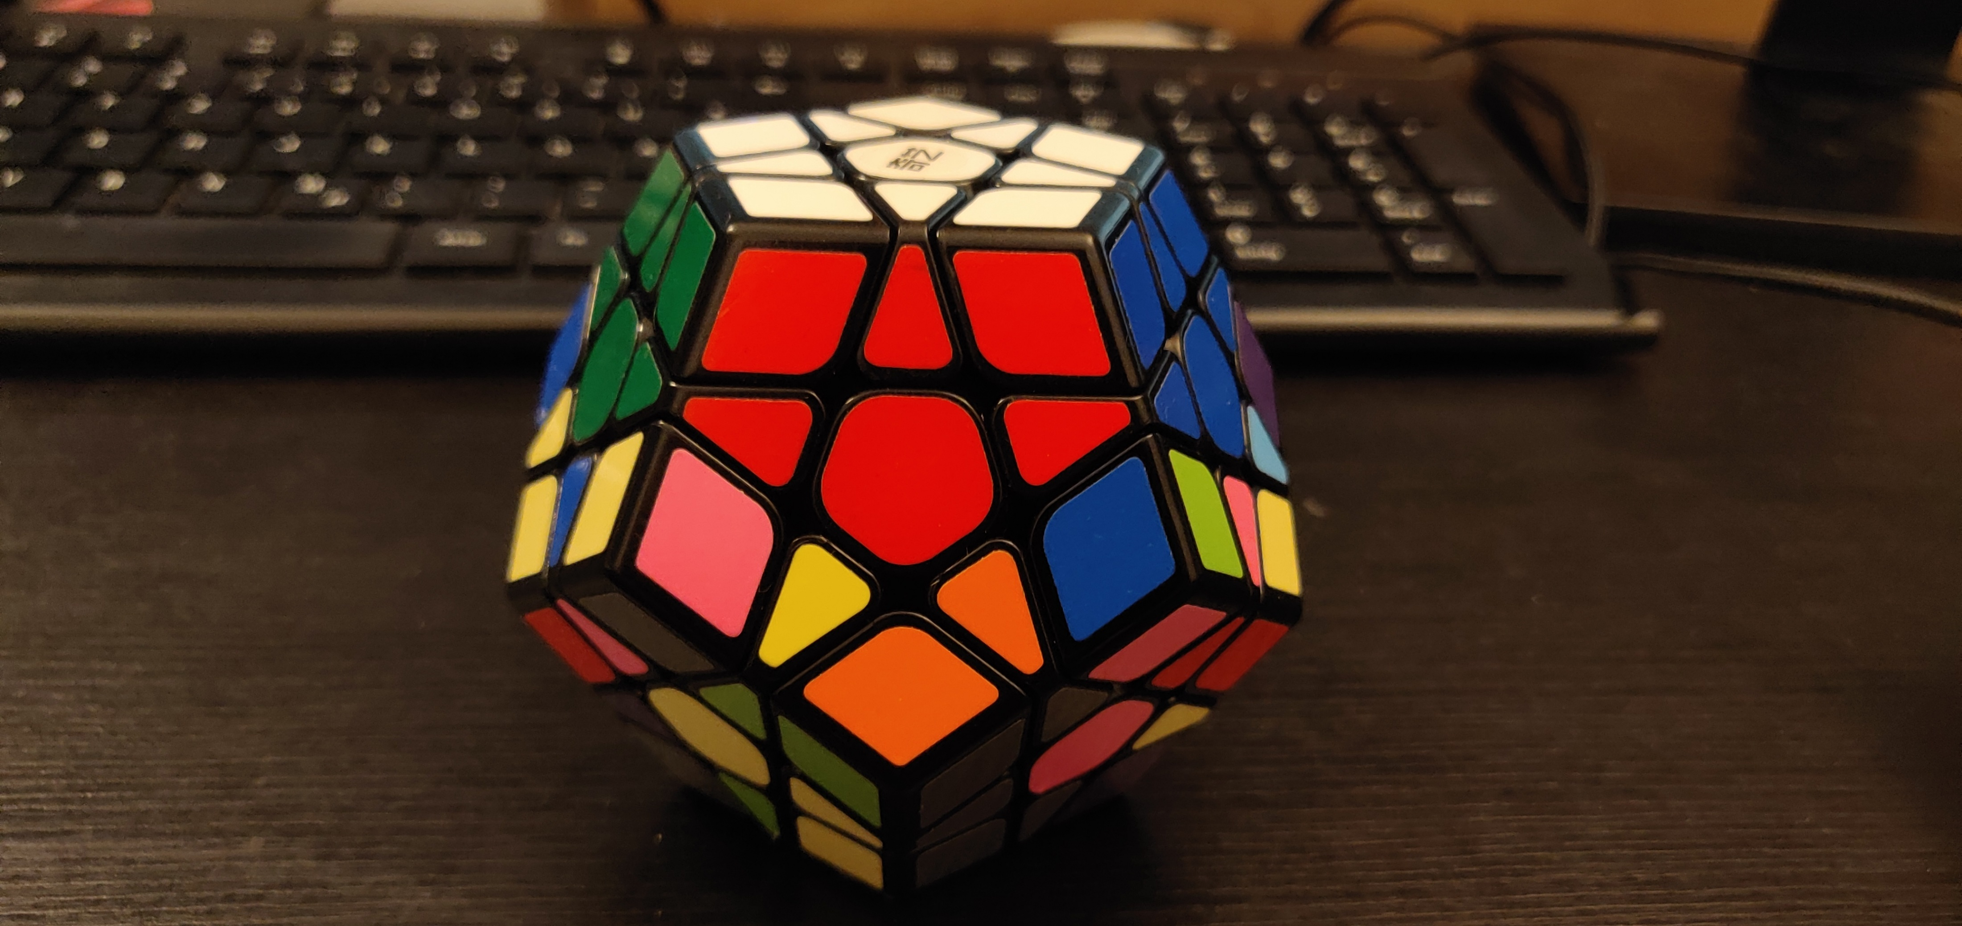
Goals
Goal 31

Slide 41
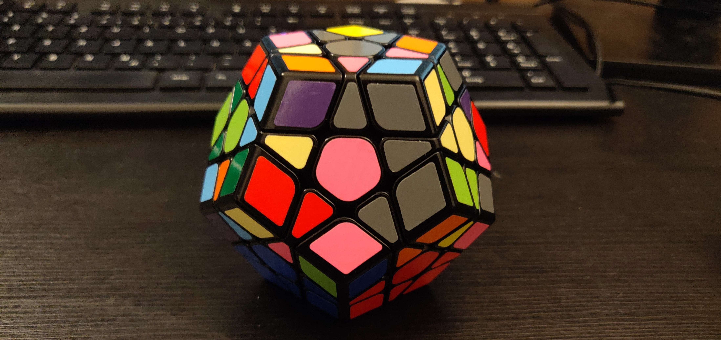
Goals
Goal 32

Slide 42
Goals
Goal 18

Slide 43
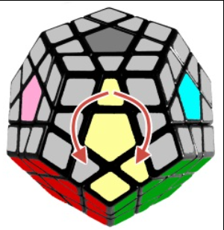
ALGORITHMS
SP3
SP4
F‘ R‘ F‘ F‘ R F
F L F F L‘ F‘

Slide 44
ALGORITHMS
SP5
SP6
SP7
U R U‘ R‘
R U R‘
(R U‘ R‘) U U R U R‘

Slide 45
ALGORITHMS
BACKUP
dl l dl‘ l‘
l dl l‘
(l dl‘ l‘) dl dl l dl l‘

Slide 46
ALGORITHMS
BACKUP
(l‘ f‘ l dl) (l dl‘ l‘ f)
(l dl l‘ dl‘ l‘) (f‘ dl f)

Slide 47
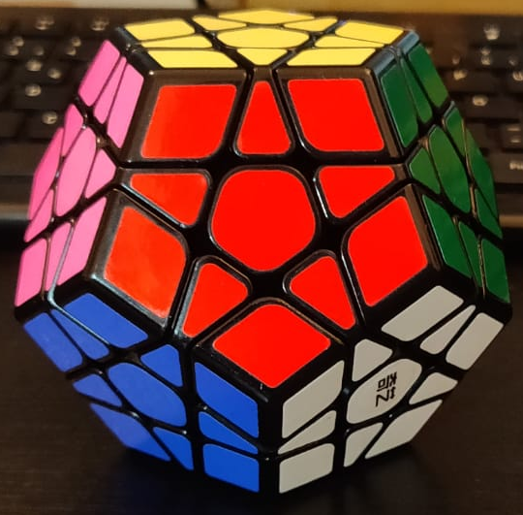
Beginning Position
U
L
R
Allowed Moves:
Up
Right
Front
Left
BACKUP
F

Slide 48
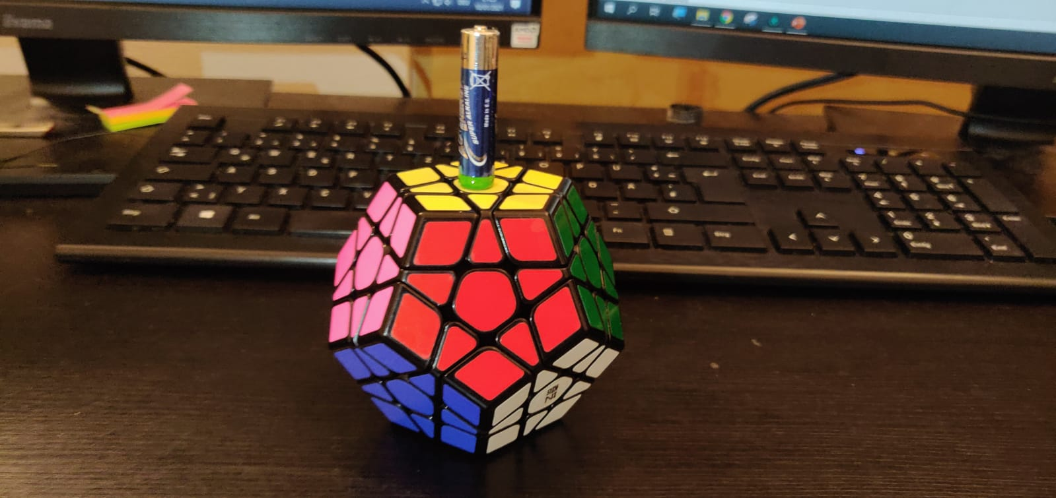
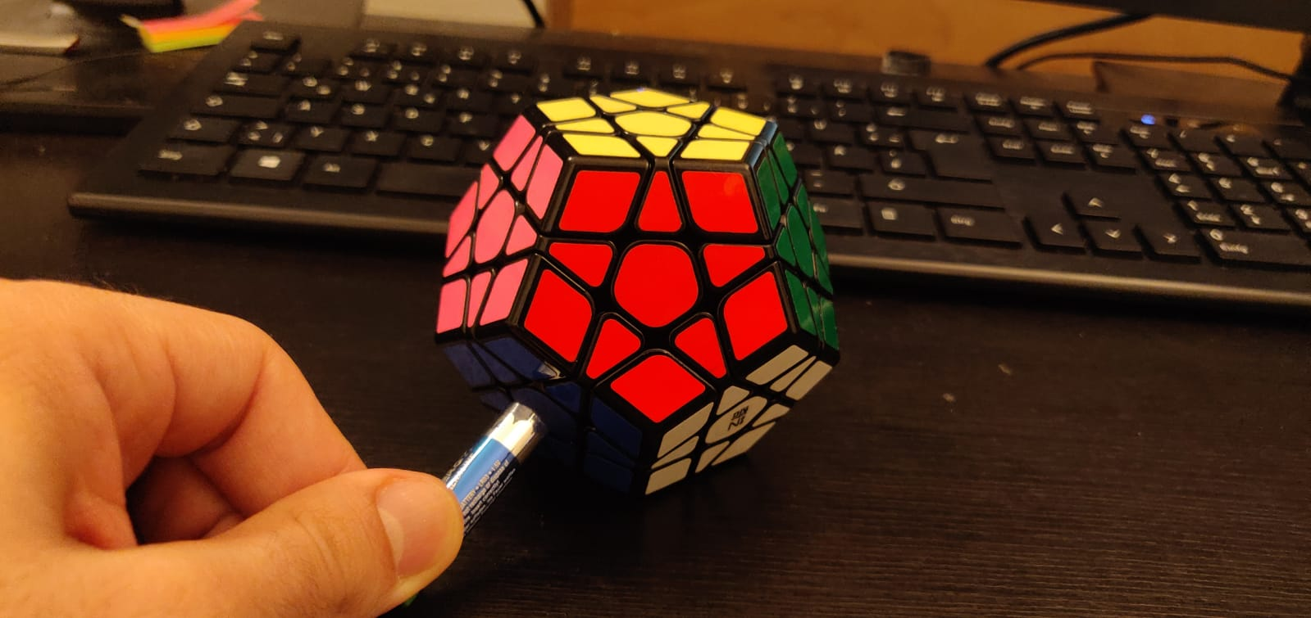
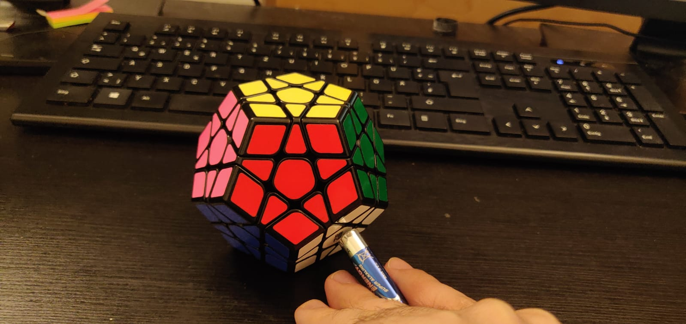
Axis Rotations
r_v
r_dr
r_dl
BACKUP

Slide 49
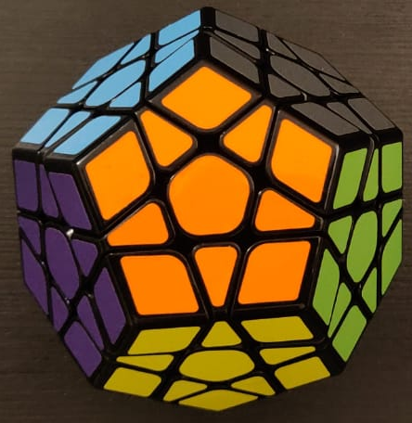
Numeration Method
u
br
bl
l
r
BACKUP
f
b
bdl
bdr
dl
dr
d

